Slide 1
Ecommerce Product Categorisation
Vysyaraju Riya
22-12-2024

Slide 2
Understanding Hackathon Problem Statement
Your mission in this hackathon is to build and train a multi-class text classifier model using the dataset provided. Your task includes the following
We aim to enhance the accuracy of predicting product categories based on textual descriptions.

Slide 3
Why It Matters
01
Accurate text classification helps businesses streamline operations, improve customer experience, and make data-driven decisions.
02
Classifying products correctly ensures better search relevance and customer satisfaction

Slide 4
Challenges in solving problem
Large number of categories (multi-class problem)
Imbalanced dataset with skewed class distribution
Variability in text length, vocabulary, and writing styles
Requirement to handle unseen data with high accuracy

Slide 5
Problem Approach
Loading Dataset
Data Exploration
Data Preprocessing
Feature Engineering
Model Development
Evaluation
Applied lemmatization to normalize text data.
Removed blank rows, irrelevant domain-specific words to enhance data quality.
Loaded the dataset and performed an initial exploration
Performed exploration on loaded data to draw quick insights
Utilized GloVe embeddings to convert text
Trained multiple models, including Logistic Regression, Random Forest, and LSTM, to evaluate performance on multi-class text classification.
Analyzed model performance metrics to identify improvement areas.
Tuned hyperparameters and fine-tuned the LSTM architecture for better results.

Slide 6
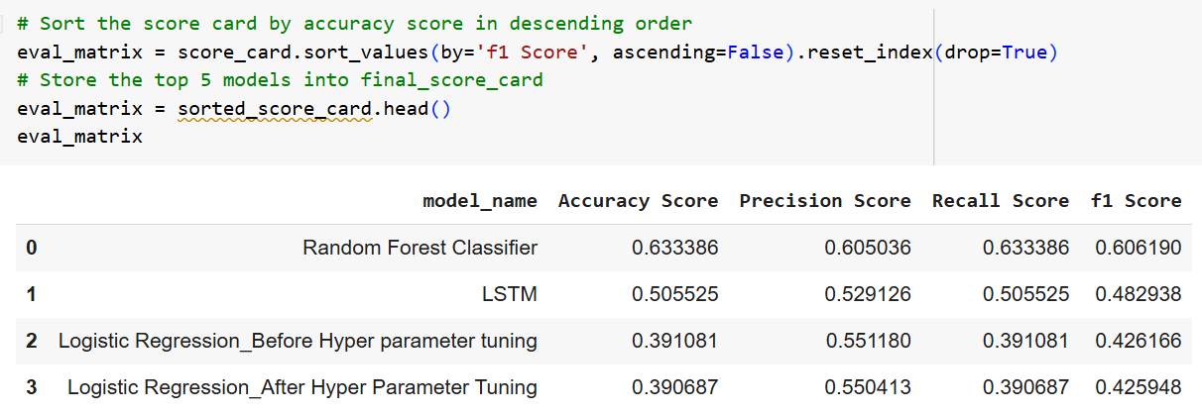
How our models performed?

Slide 7

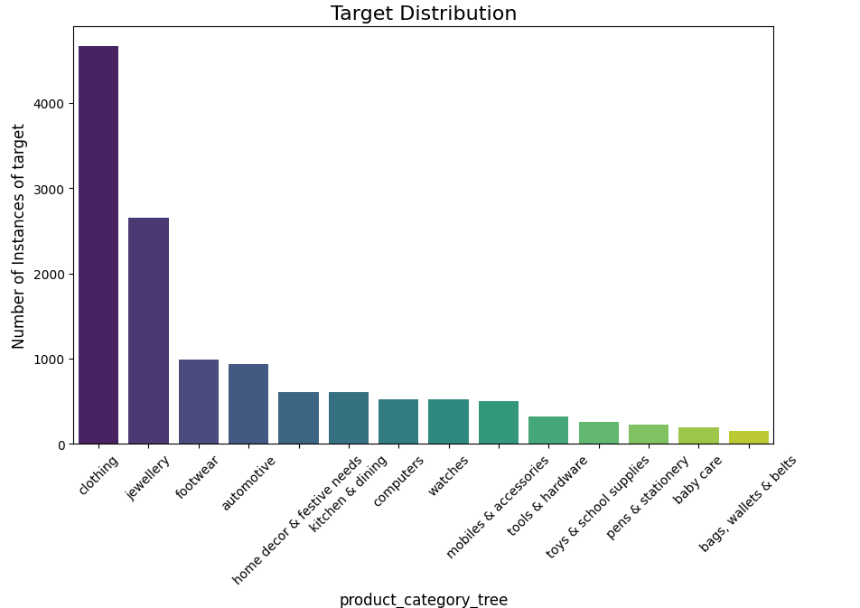
Insights
The platform's top-selling category is Clothing, closely followed by Jewellery. Sales are moderate in categories like Footwear, Automotive, Mobile Accessories, Home Decor, Kitchen and Dining, and Computers. On the other hand, categories such as Bags, Wallets, and Belts, along with Baby Care, Pens and Stationery, Toys, Tools, and Watches, have the lowest sales.

Slide 8
Categories such as Bags, Wallets & Belts, Baby Care, Pens & Stationery, Toys & School Supplies, Tools & Hardware, and Watches are the least selling.
Business Opportunity: Assess whether to reduce inventory in these categories, diversify product offerings, or exit these segments altogether if they are not profitable.
Business Opportunity

Slide 9
Conclusion:
To conclude, I’ve successfully applied three different models: LSTM for sequence learning, Random Forest for ensemble learning, and Logistic Regression for linear classification. Each model was trained, evaluated, and compared to ensure we get the best performance for the given problem. Depending on the data’s nature, we can choose the best-performing model. In our case, LSTM showed the best performance for sequential tasks, while Random Forest provided a solid alternative for non-linear relationships

Slide 10


Impacts of Solving Problem
Higher Conversion Rates: By making relevant products easier to find, customers are more likely to make purchases, positively impacting revenue.
Reduced Returns: Improved product discovery can reduce instances where customers buy incorrect items, reducing return rates and associated costs.

Slide 11

Thank you!
Your most unhappy customers are your greatest source of learning - Bill Gates

